Slide 1

Live Oak Bank Presentation
Damon Neanover

Slide 2
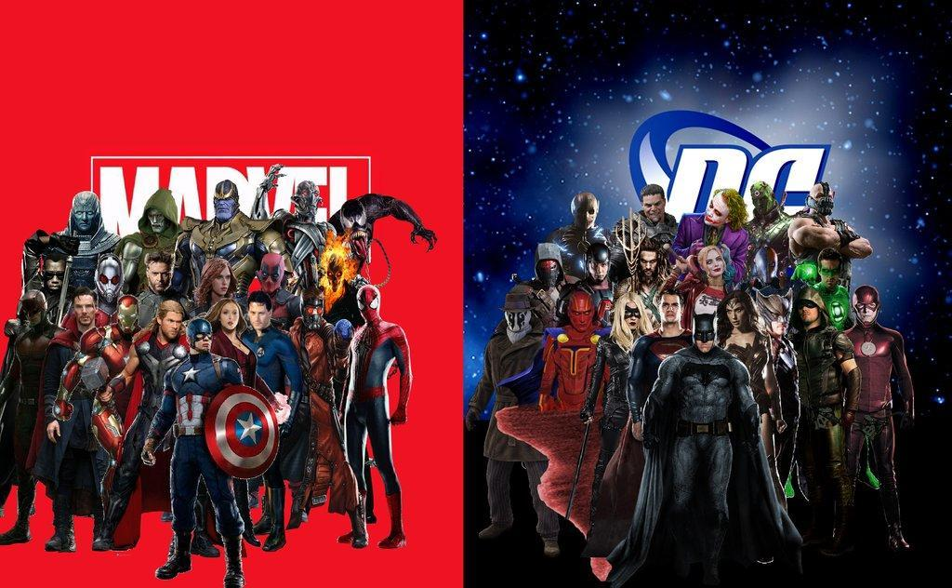

Slide 3
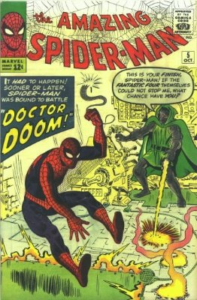
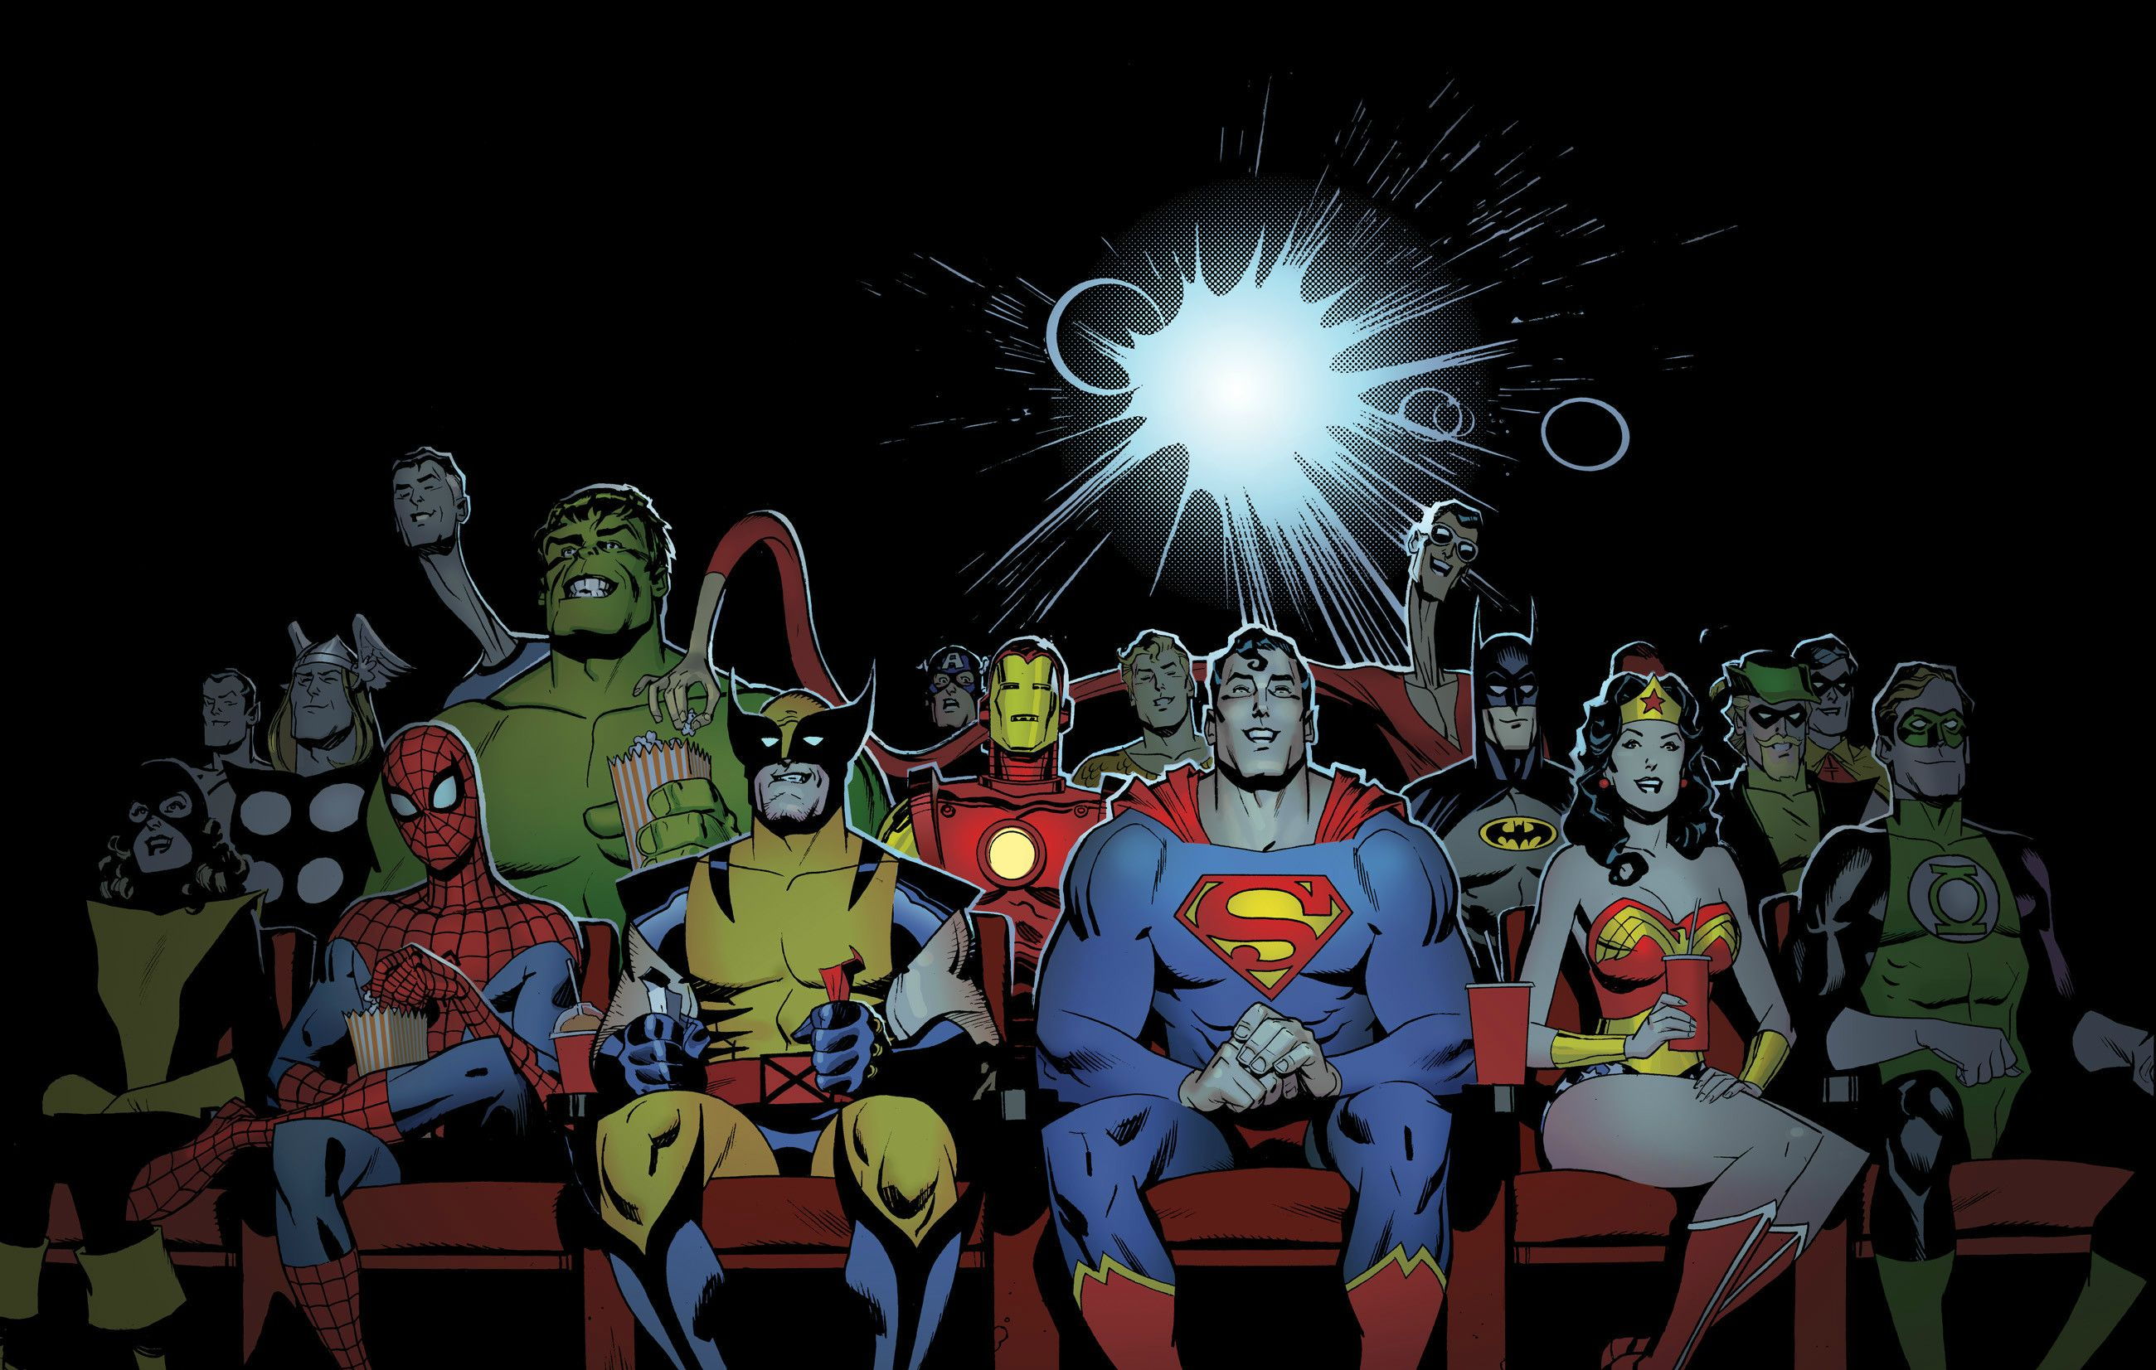

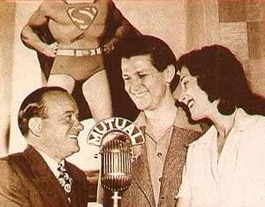


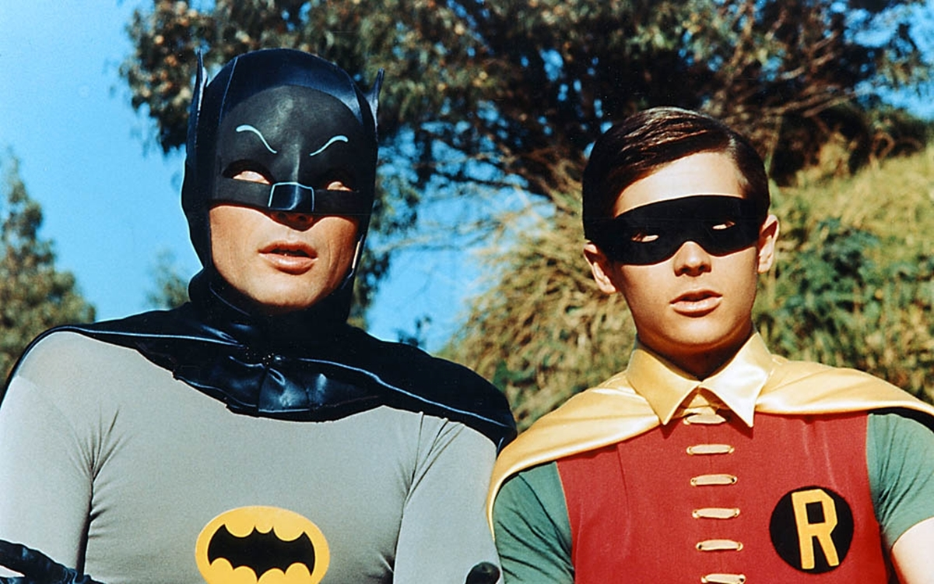

Slide 4
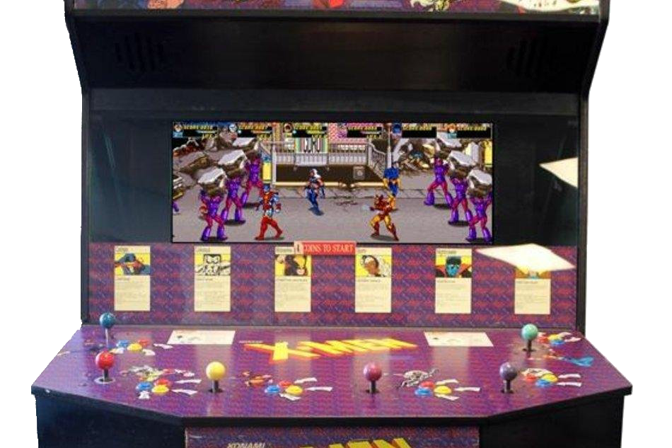
Super Hero Video GAmes

Slide 5


3-4

Slide 6
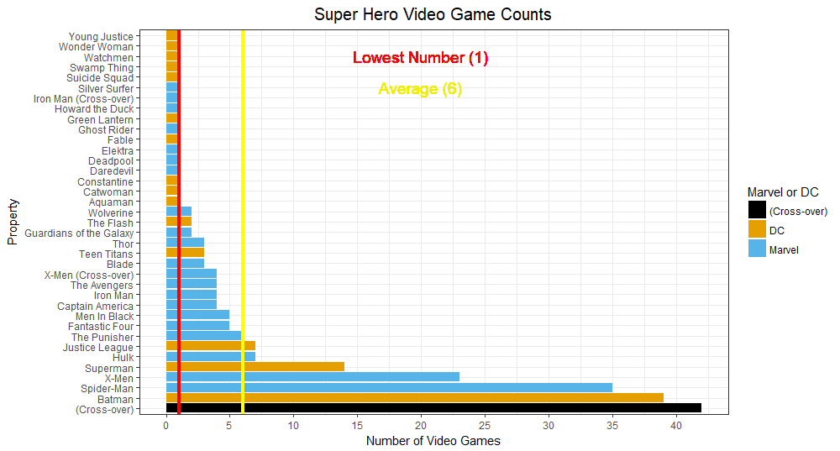
233
Games

Slide 7
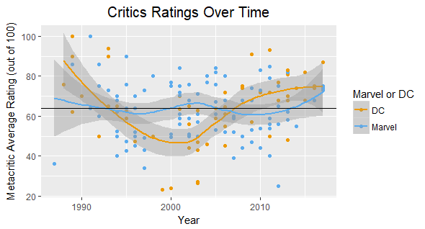
History of Video Game Ratings
 | Games | Min | Mean | Max
Marvel | 96 | 25 | 63.23 | 100
DC | 61 | 23 | 64.29 | 100
ALL | 157 | 23 | 63.77 | 100
 | At or Above Average # | At or Above Average %
Marvel | 48 | 50%
DC | 38 | 62%

Slide 8
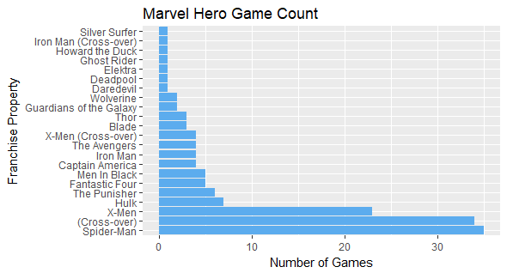
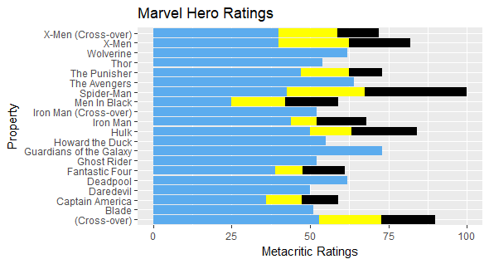
Marvel Game Count and Ratings
 | Min | Q1 | Mean | Q3 | Max
Marvel | 25 | 52 | 63.23 | 75 | 100
 | Min | Mean | Median | Max | Total
Marvel | 1 | 6.7 | 3.5 | 35 | 96

Slide 9
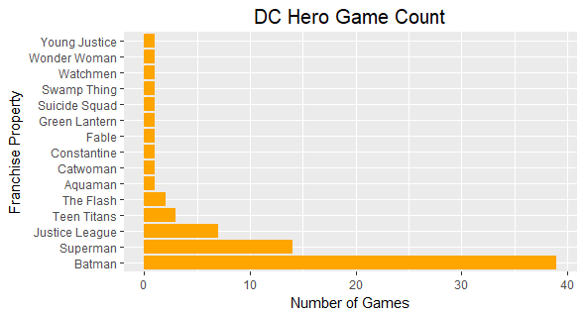
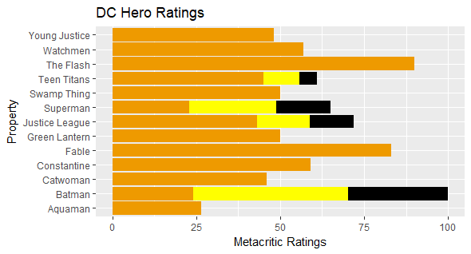
DC Game Count and Ratings
 | Min | Q1 | Mean | Q3 | Max
DC | 23 | 55 | 64.63 | 75 | 100
 | Min | Mean | Median | Max | Total
DC | 1 | 5.2 | 1 | 39 | 61

Slide 10
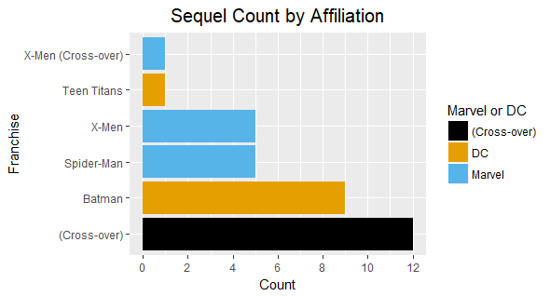
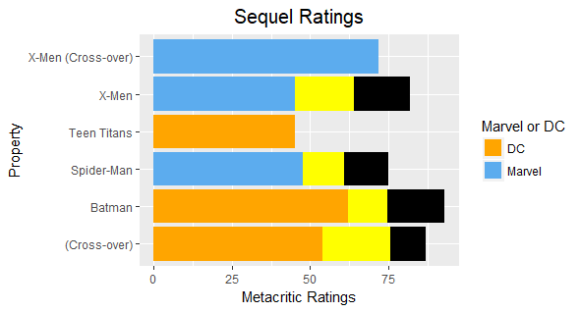
Sequel Counts and Ratings
 | Min | Mean | Max
Marvel | 45 | 68.90 | 85
DC | 45 | 73.00 | 93
 | Min | Mean | Max | Total
Marvel | 1 | 4 | 5 | 11
DC | 1 | 5 | 9 | 10
All | 1 | 5.5 | 12 | 33

Slide 11
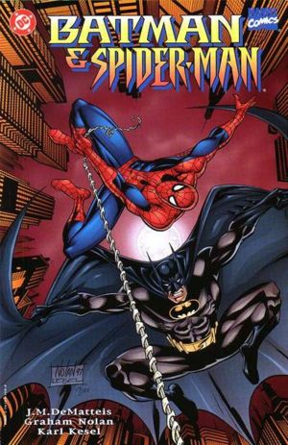
Champion Battle
 | Spider-Man | Batman | Advantage
Number of Games | 21 | 31 | Batman
Average Game Score | 67.51 | 70.34 | Batman
Worst Game | 42.5 | 24 | Spiderman
Best Game | 100 | 100 | Tie
Sequel Count | 5 | 9 | Batman
Sequel Average | 60.76 | 75 | Batman
Sequel Min | 47.5 | 62 | Batman
Sequel Max | 75 | 93 | Batman
Spider-Man:1 Batman : 6

Slide 12
Showdown Summary
 | Marvel | DC | Winner
Number of Games | 94 | 61 | Marvel
Percent above Average | 50% | 62% | DC
Average Game Rating | 63.23 | 64.29 | DC
Worst Game | 25 | 23 | Marvel
Best Game | 100 | 100 | Tie
Number of Sequels | 11 | 10 | Marvel
Sequel Average Rating | 68.90 | 73.00 | DC
Best Hero Showdown | Spider-Man | Batman | DC
Marvel: 3 DC:4

Slide 13

Winner

Slide 14
Questions?

